Slide 1
Gottfried Konency AND CHina - Celebrating His 90’s Birthday
Deren Li, Yixuan Zhu & Lily Shi
Wuhan University
2020.06.17

Slide 2
Our Best Friend in Photogrammetry and Remote Sensing of China
Actively promote the development of photogrammetry and remote sensing education in China
Firmly support China's participation in the activities of the International Society for Photogrammetry and Remote Sensing
Vigorously promote the research of photogrammetry and remote sensing in China to catch up with the world level
A thriving friendship with Chinese scholars in photogrammetry and remote sensing
1978: Visited China for the first time, and made a special trip to Wuhan to visit Prof. Wang Zhizhuo
1979: Visited China again with a German surveying and mapping delegation
1980: Visited Wuhan Institute of Surveying and Mapping to give lectures for about two weeks in photogrammetry and remote sensing
Providing full scholarships for students to study at Leibniz University Hanover in the 1980’s
Continuously supporting China for the photogrammetry and remote sensing education and research since then

Slide 3
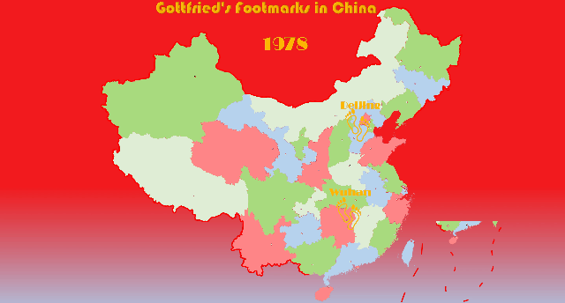

Slide 4
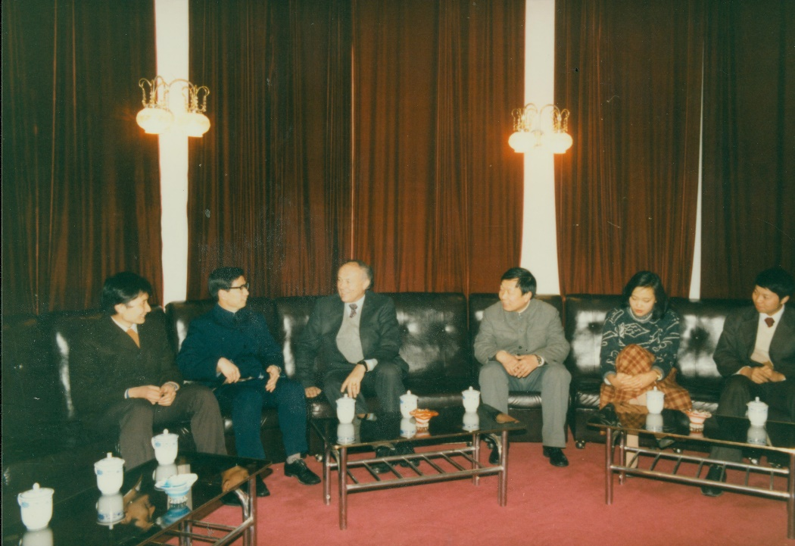
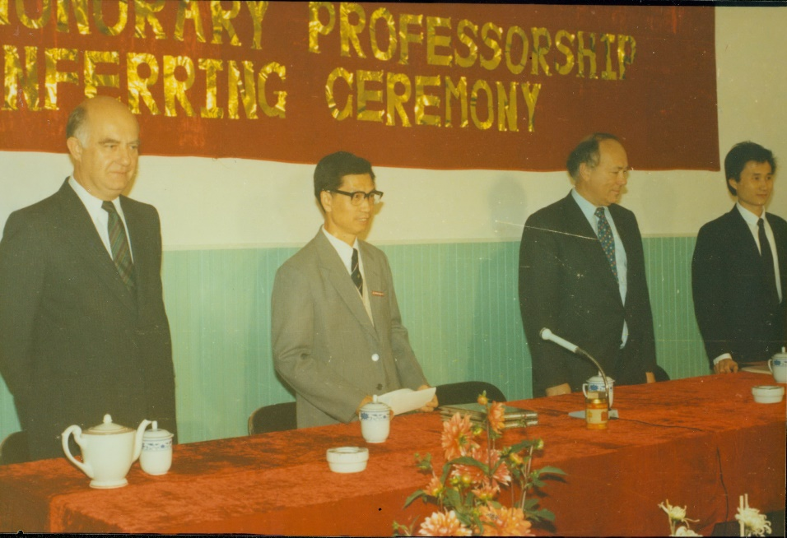
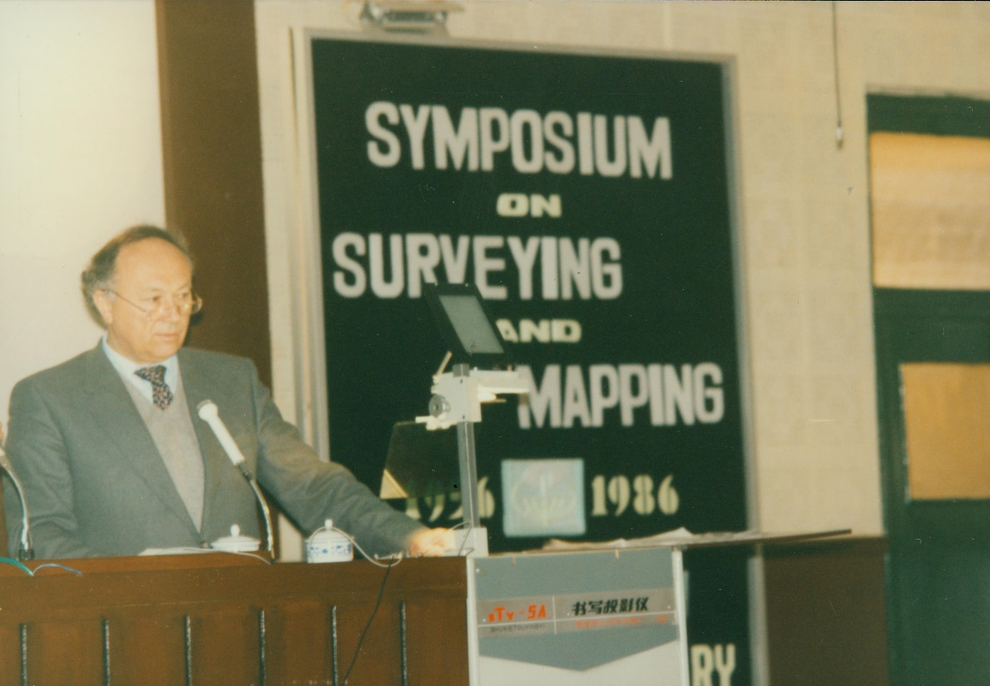
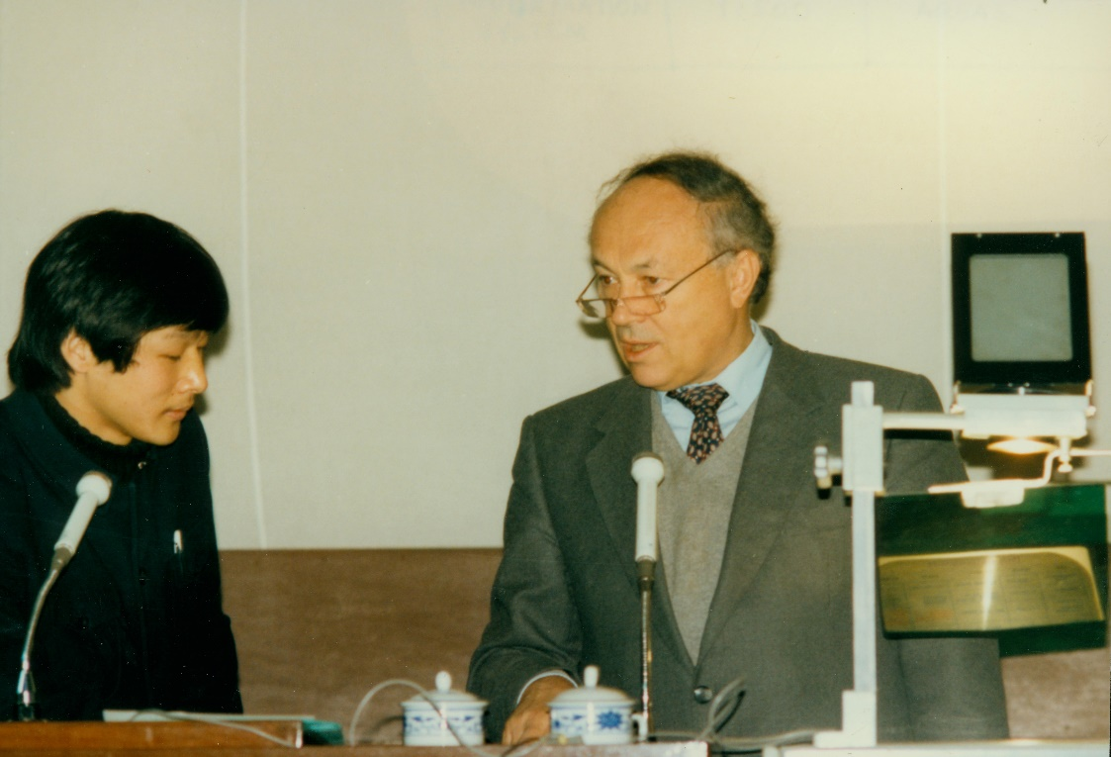
1986, Wuhan, Honorary Professorship

Slide 5
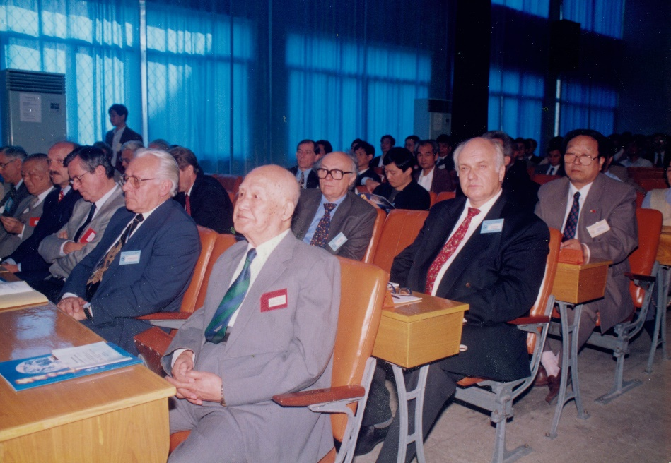
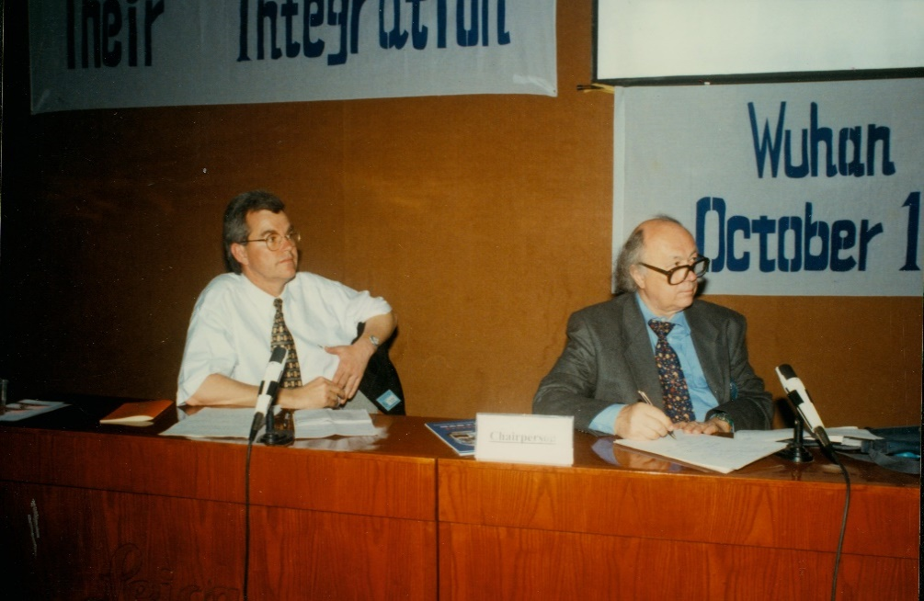
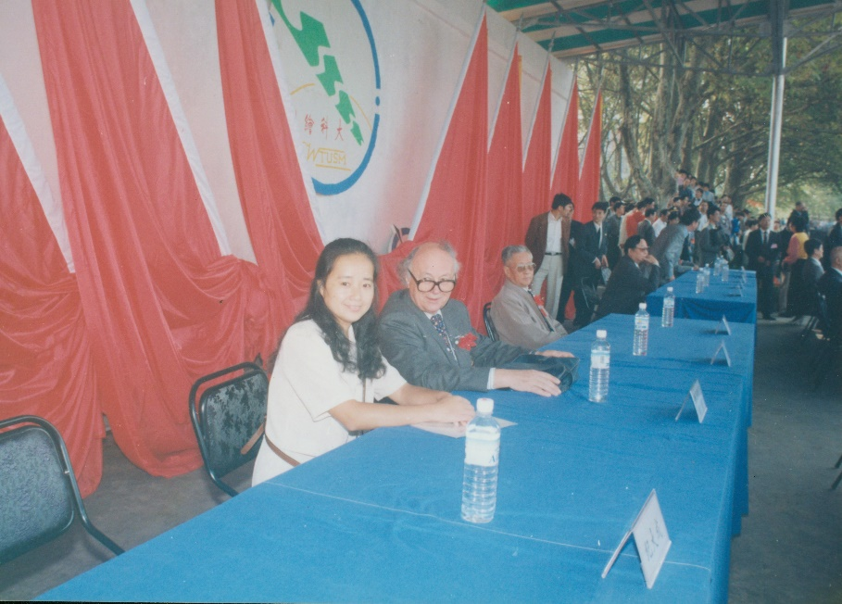
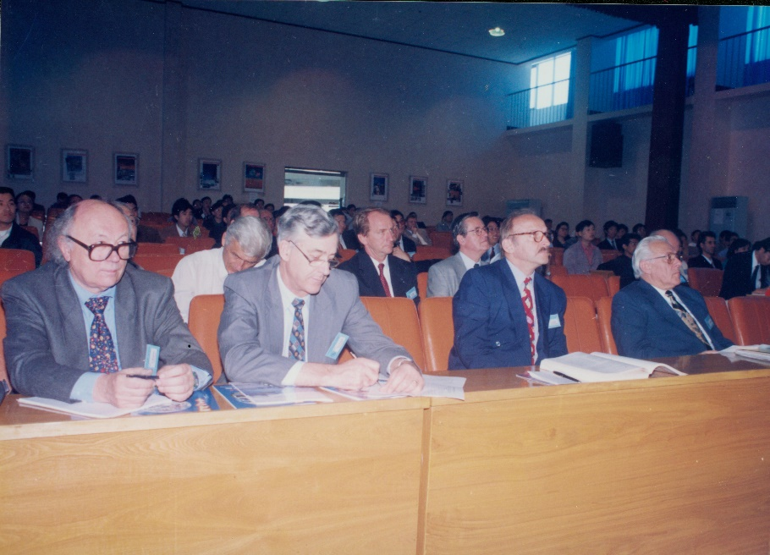
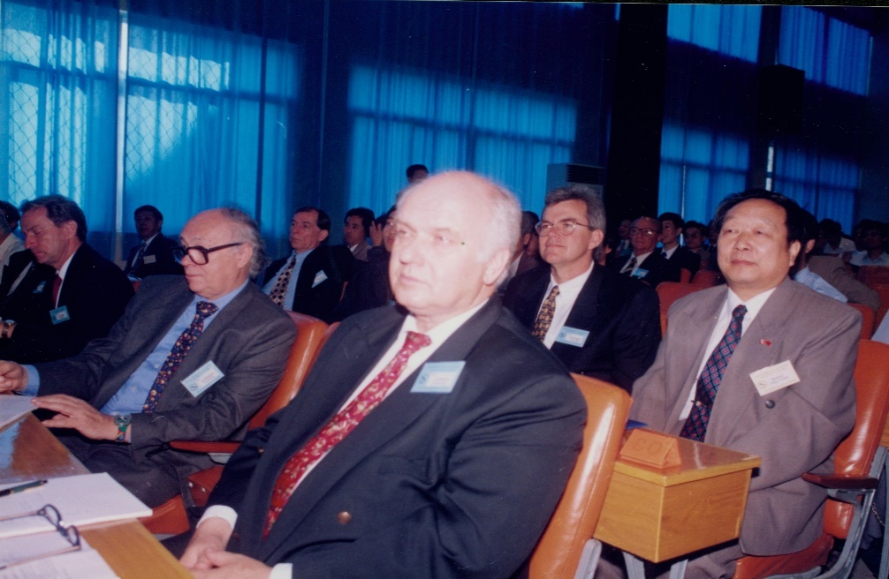
1988, Wuhan, Workshop

Slide 6
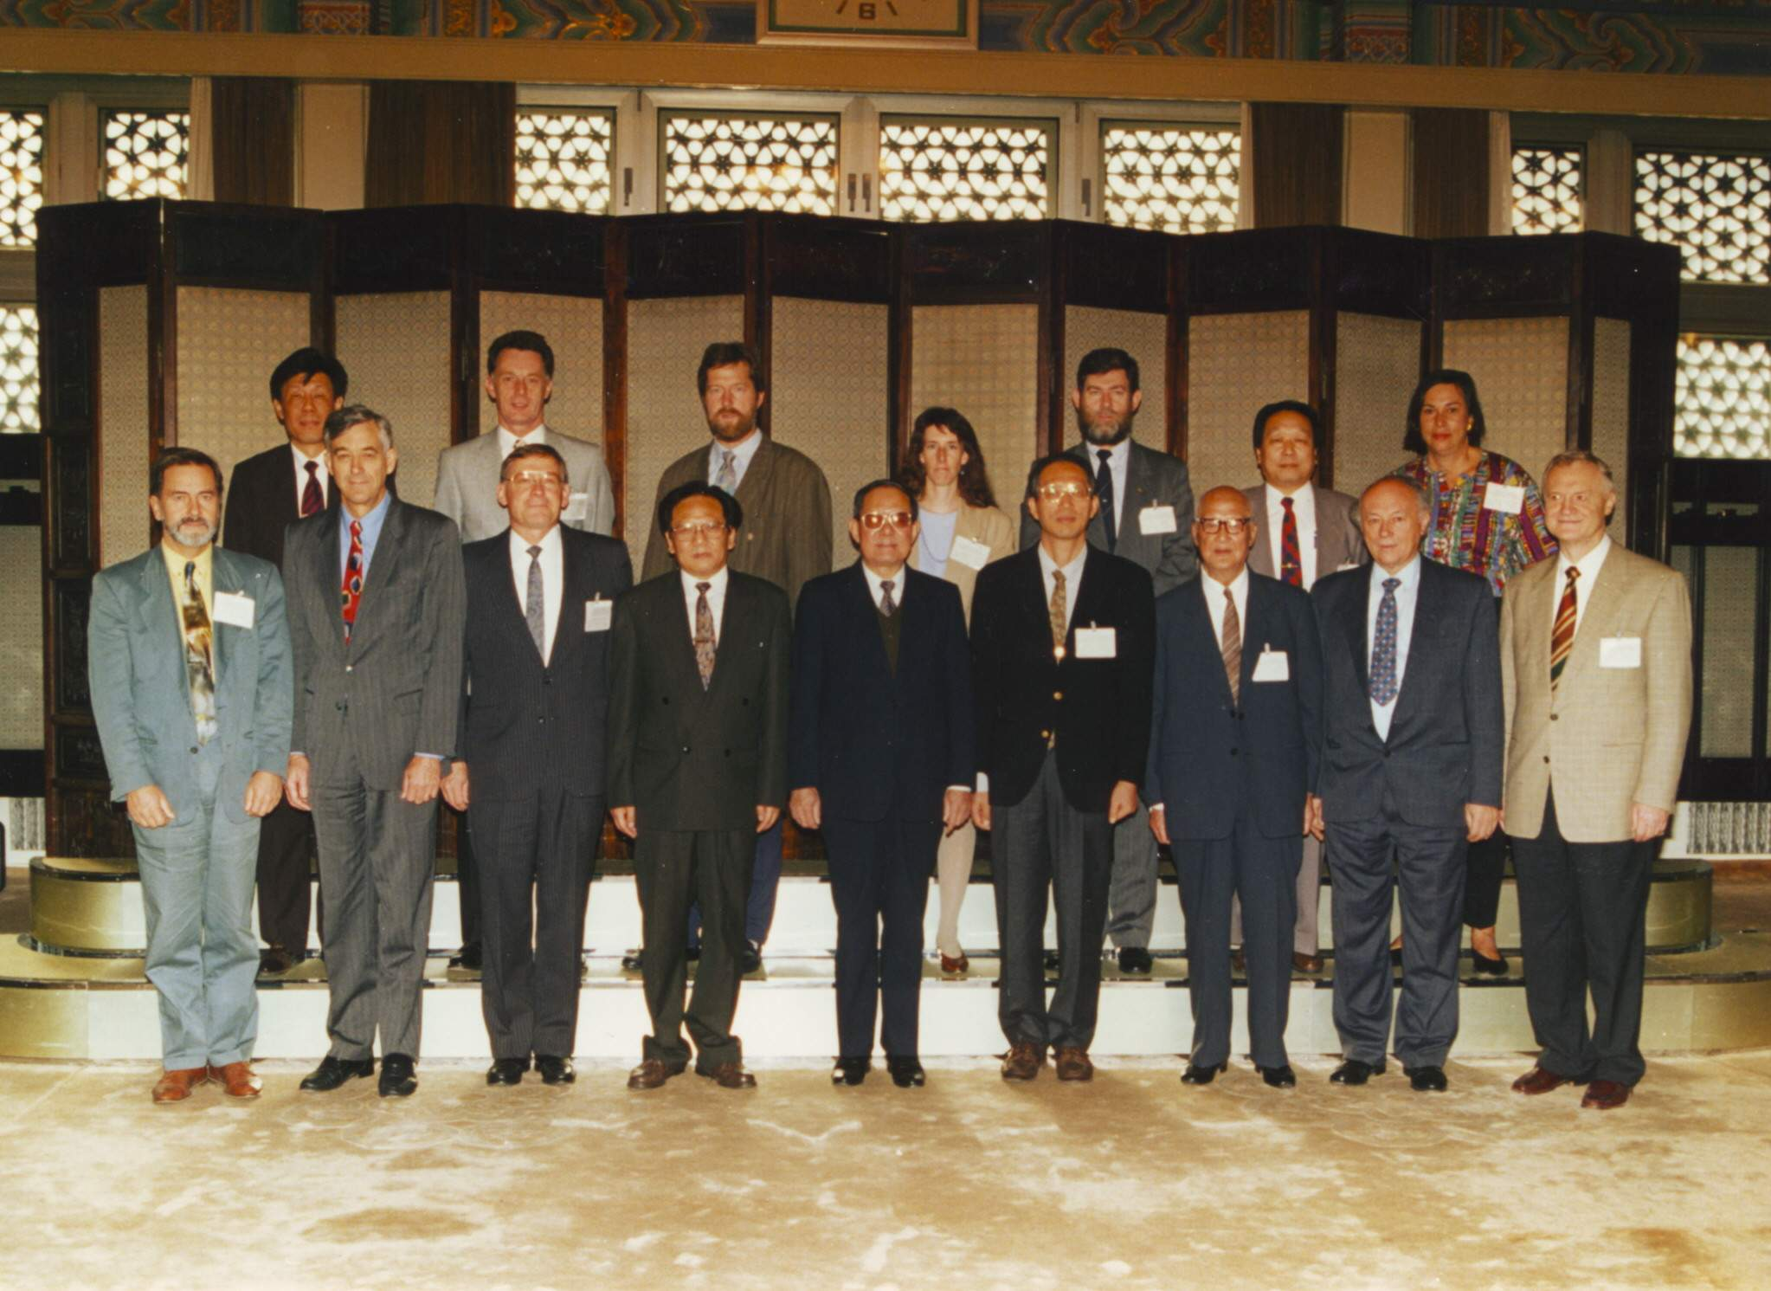
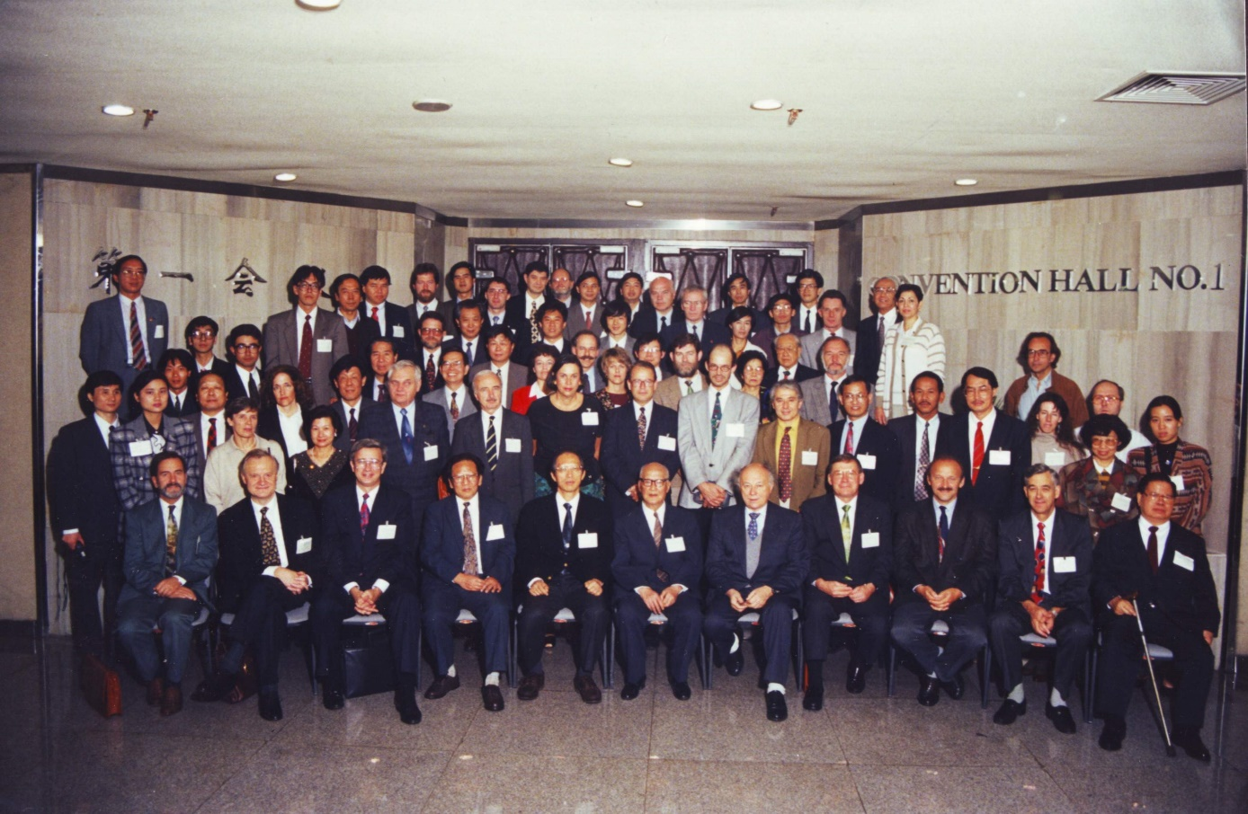
1994, Beijing, ISPRS Commission VI Symposium

Slide 7
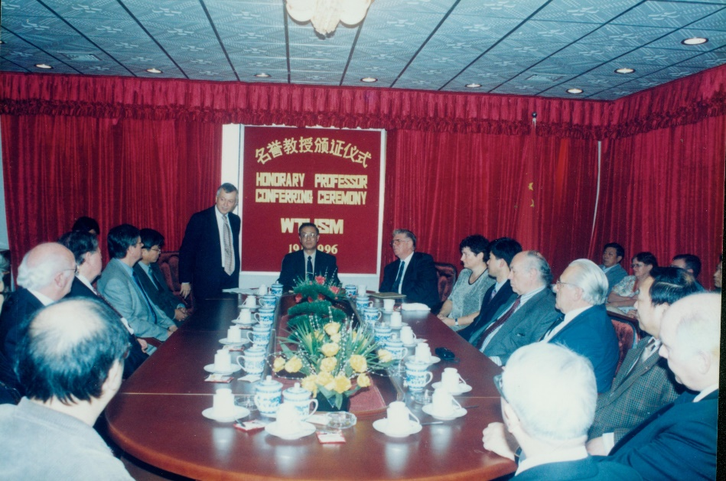
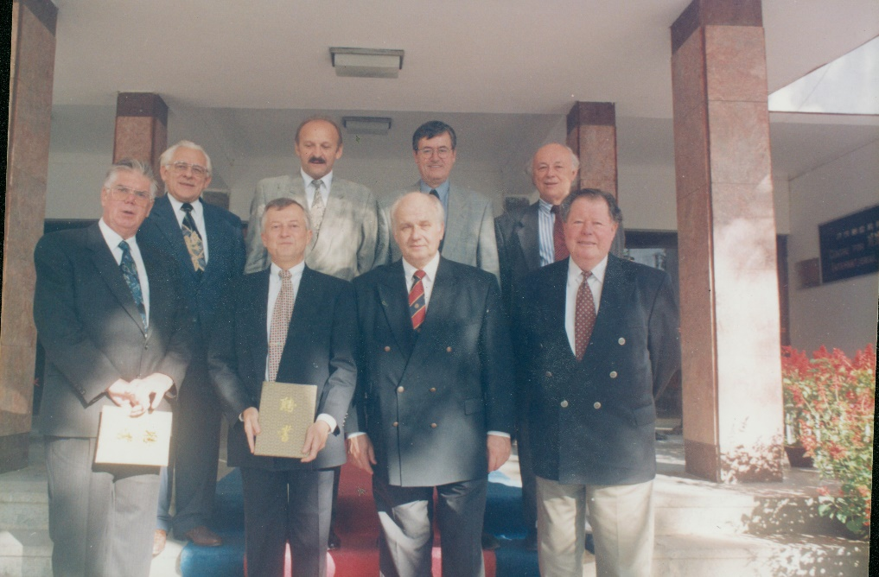
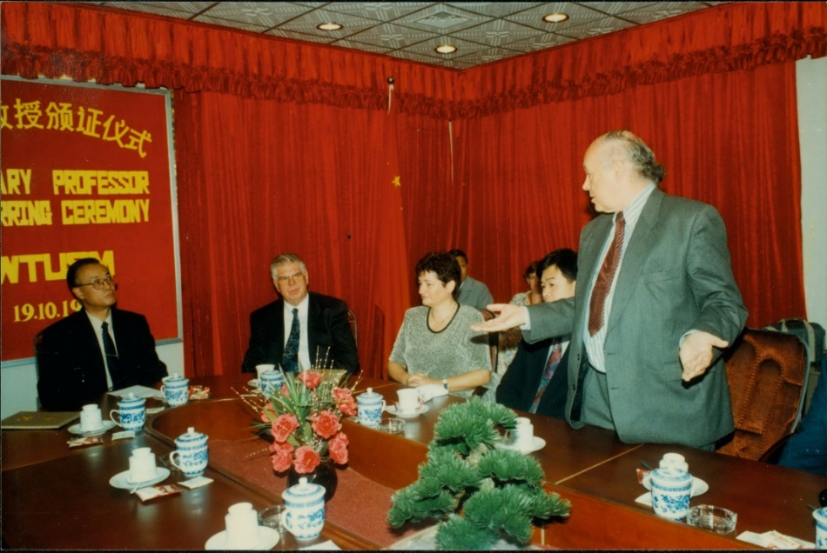
1996, Wuhan, Honorary Professorship

Slide 8
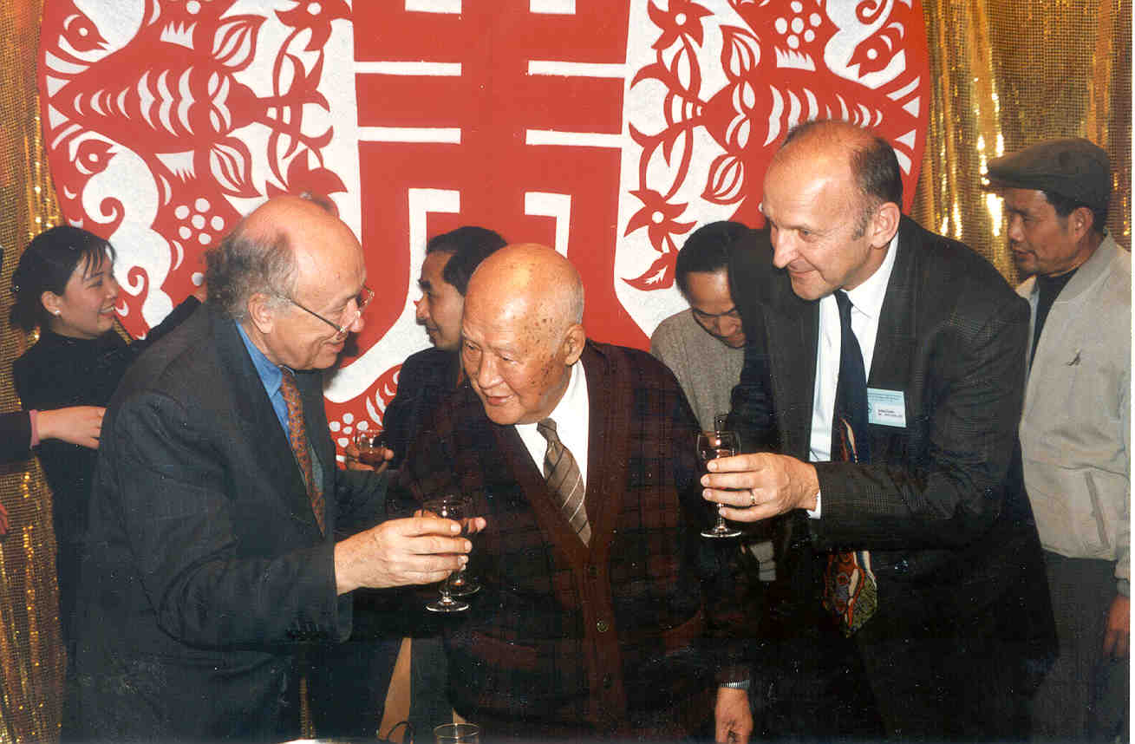
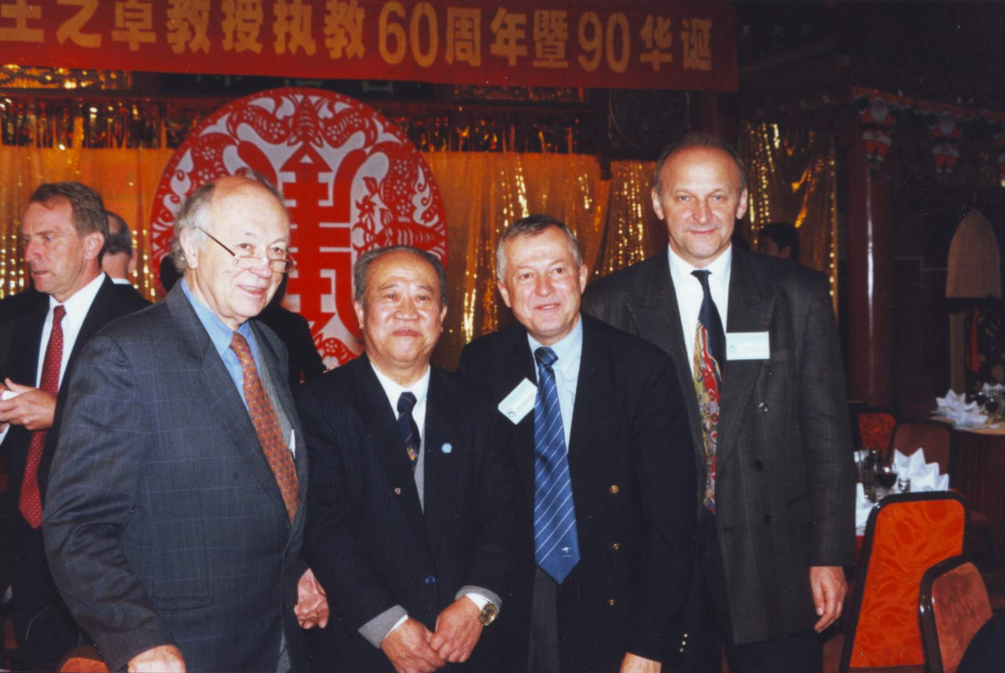
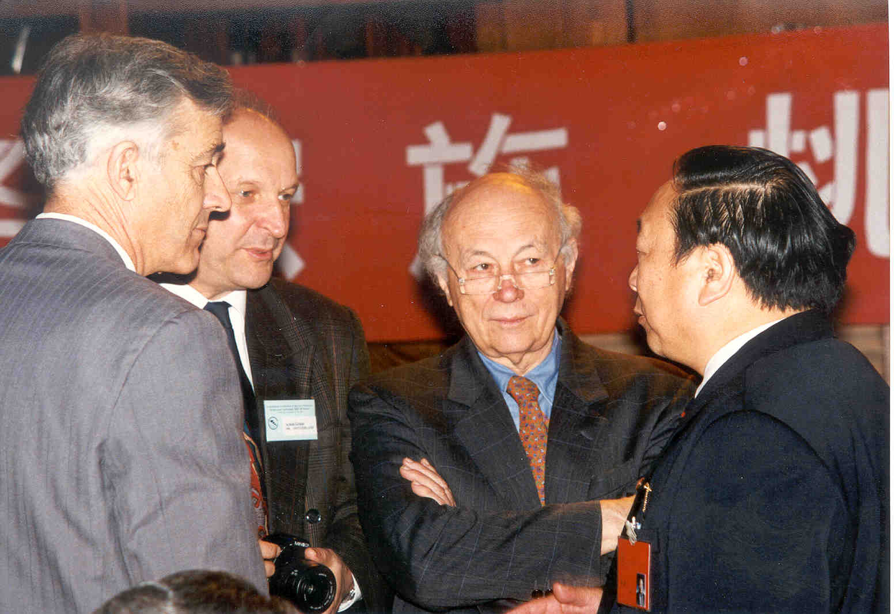
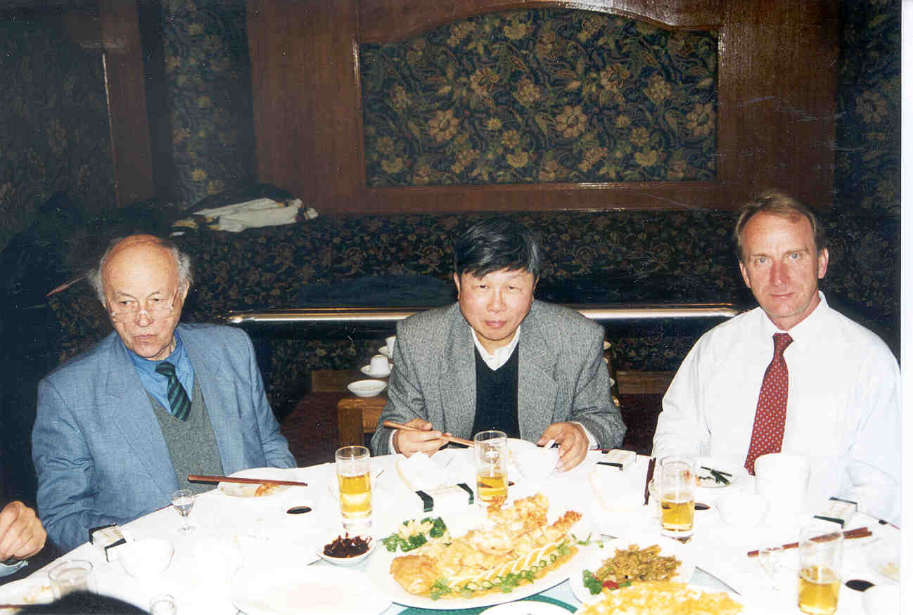
1998, Wuhan, Wang Zhizhuo’s 90th Birthday

Slide 9
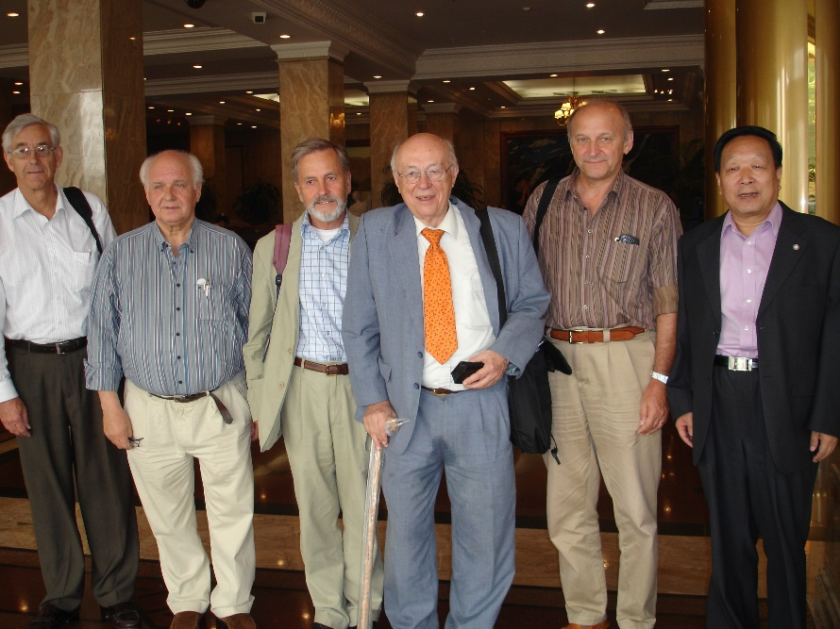
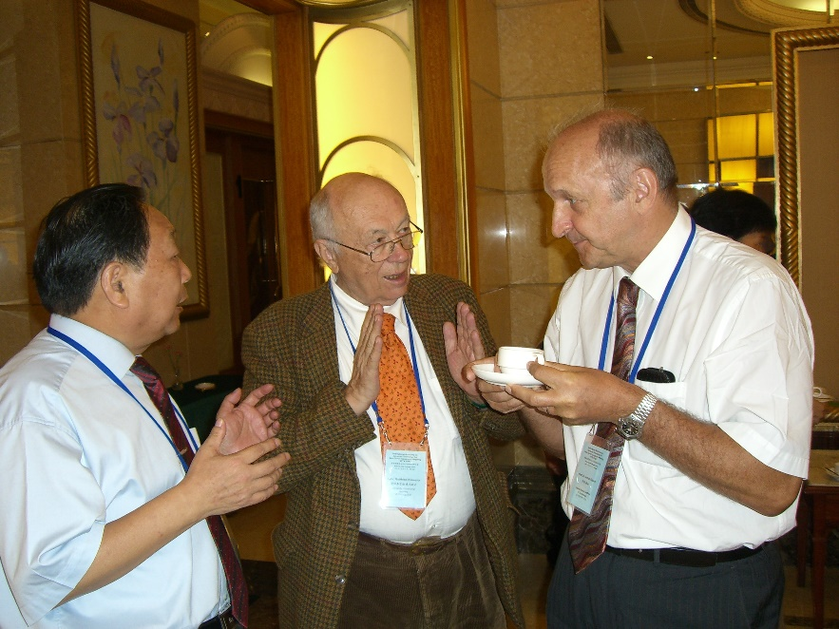
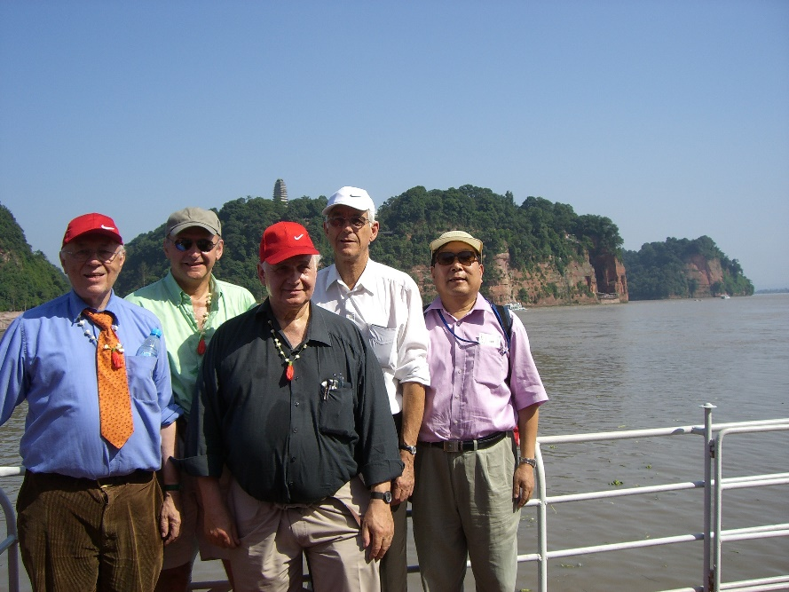
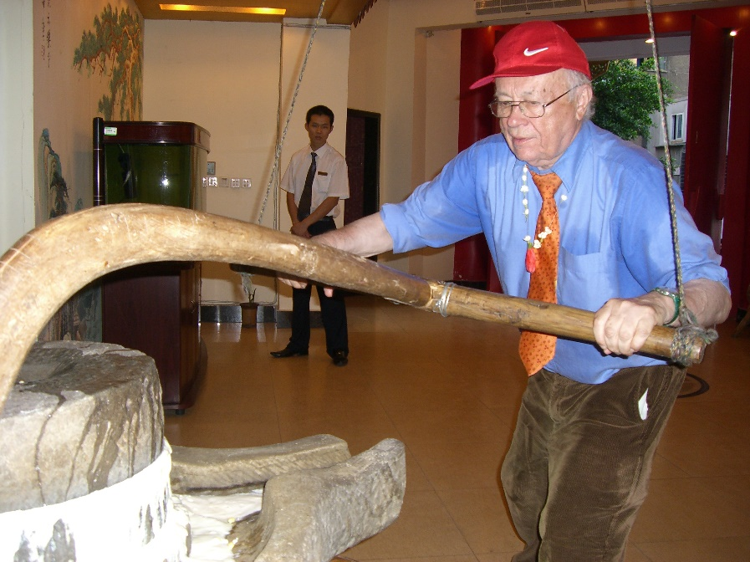
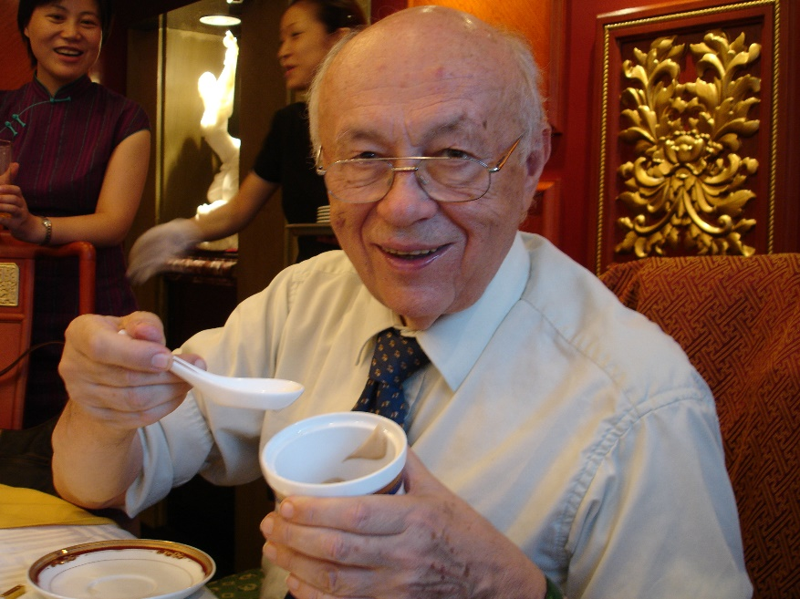
2006, Chengdu, Workshop on Mapping in Western China

Slide 10
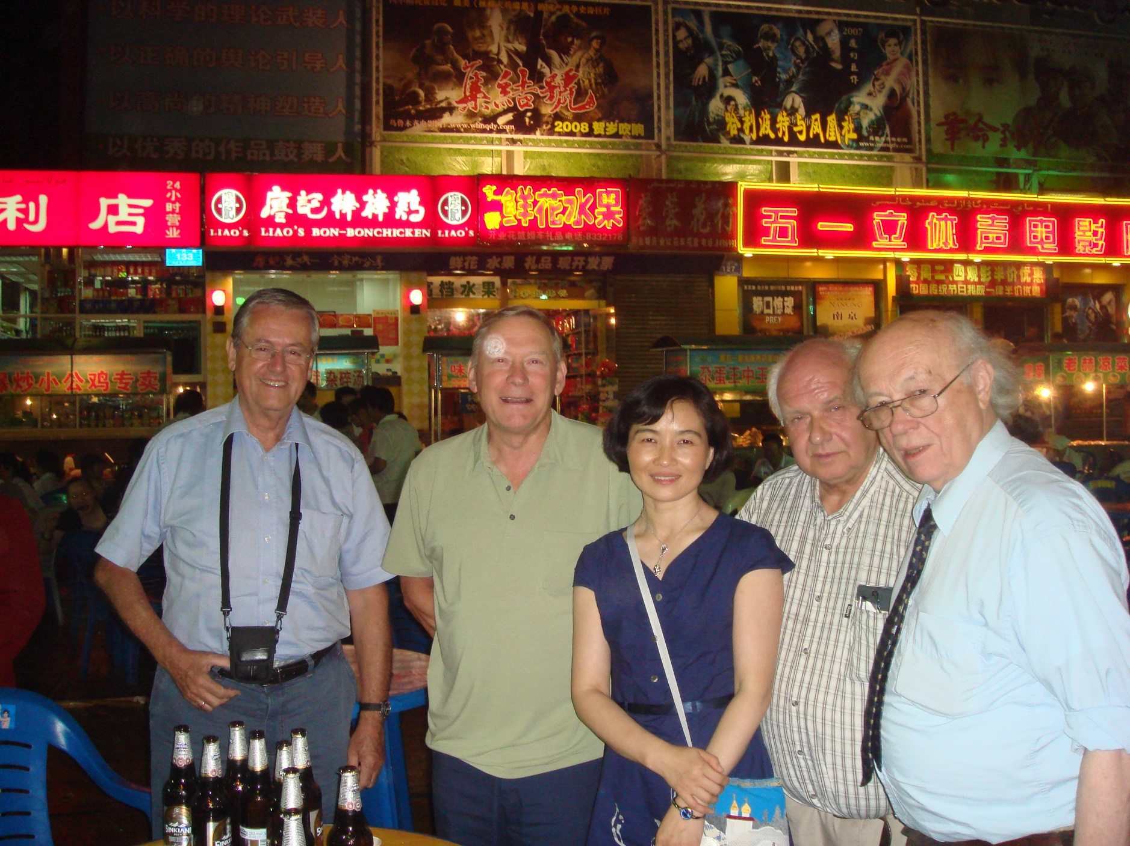
2007, Urumqi

Slide 11
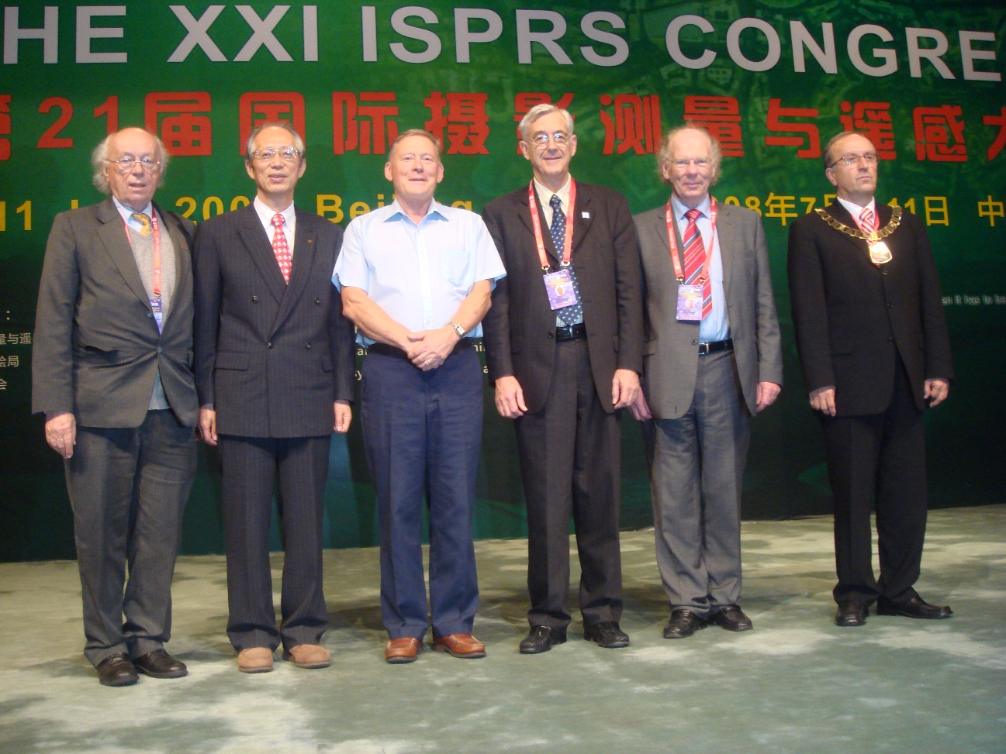
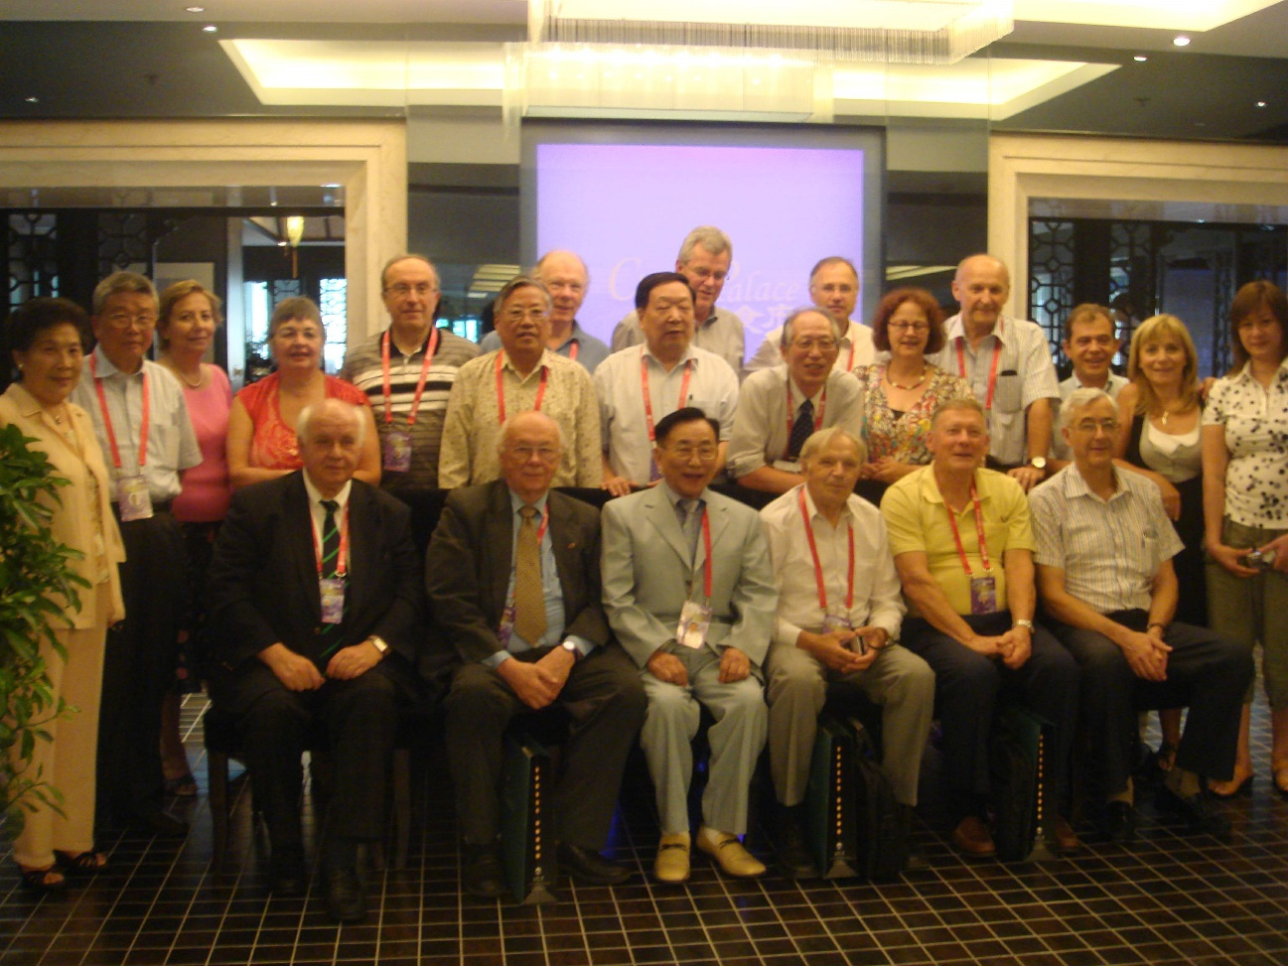
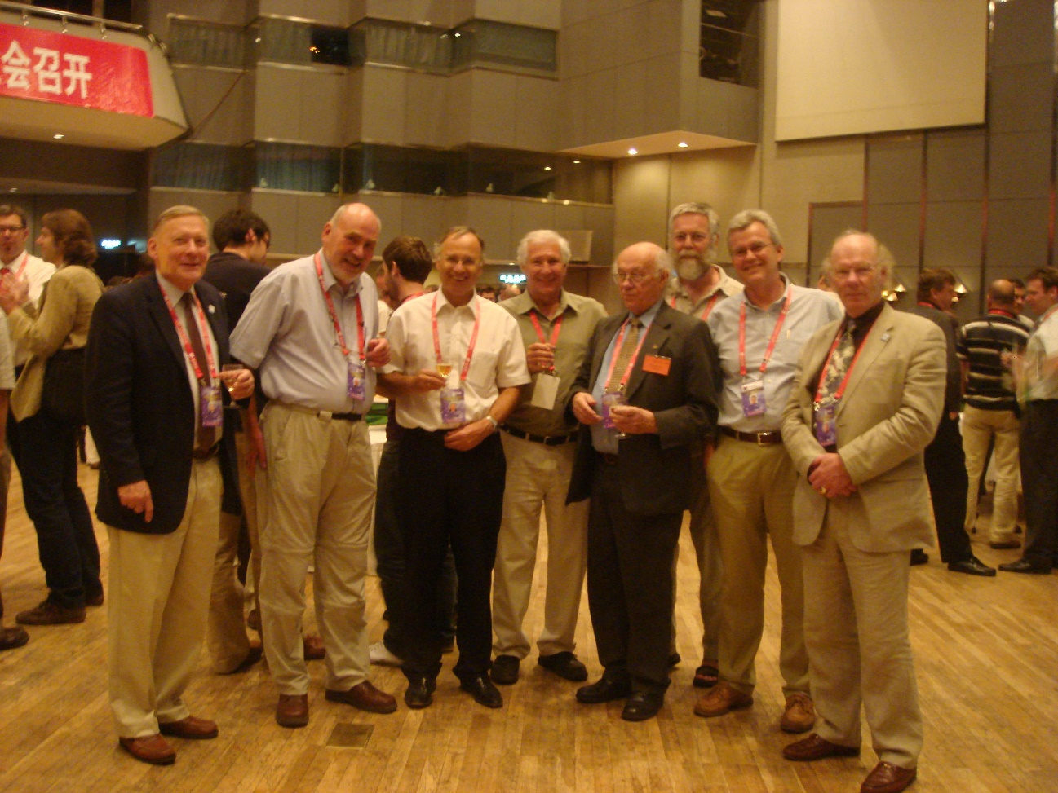
2008, Beijing, XXI ISPRS Congress and White Elephant Club Party

Slide 12
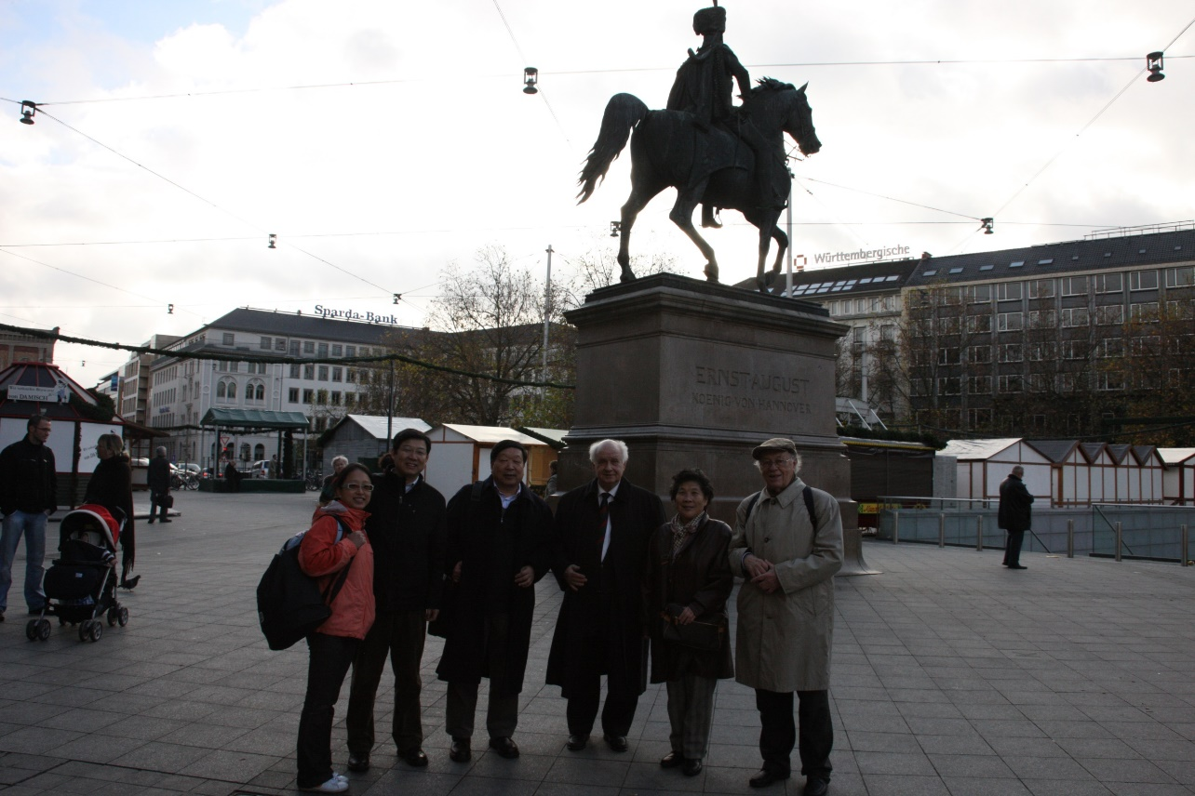
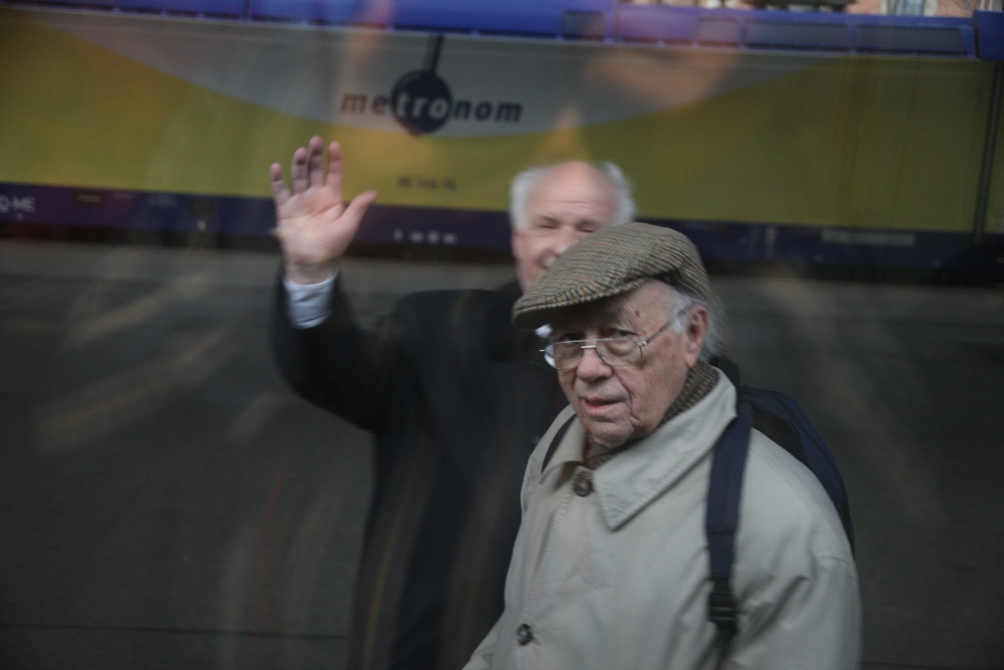
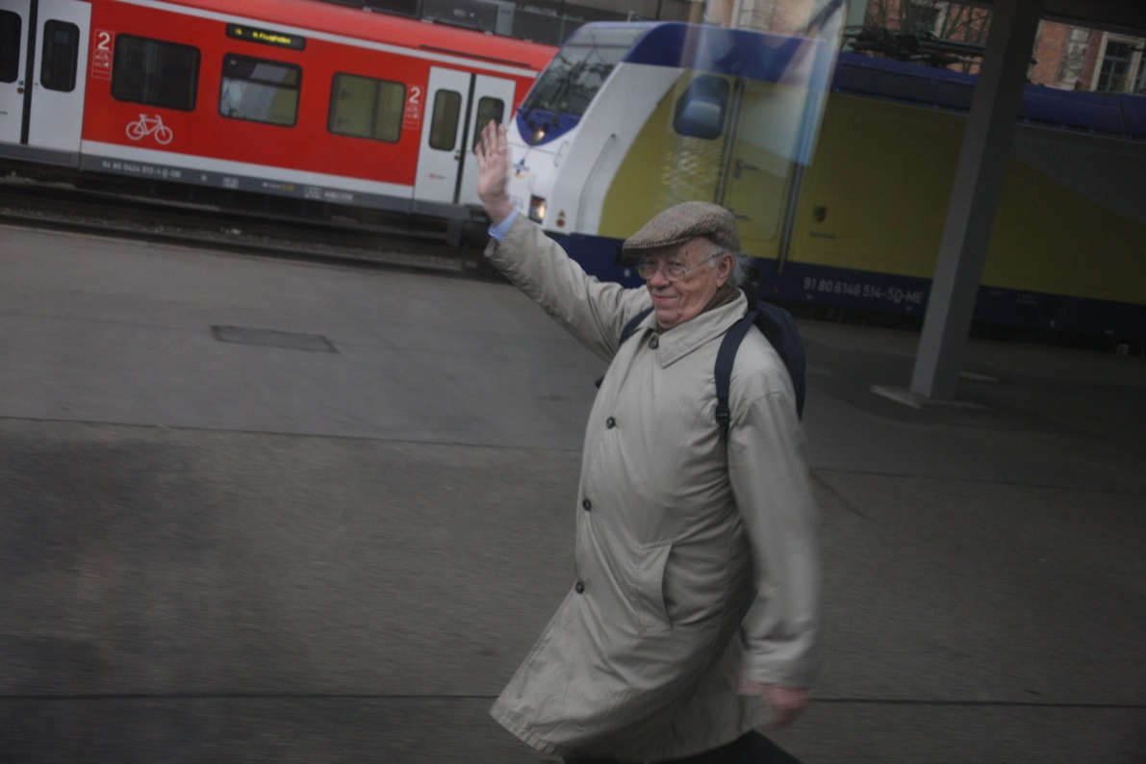
2008, Hanover

Slide 13
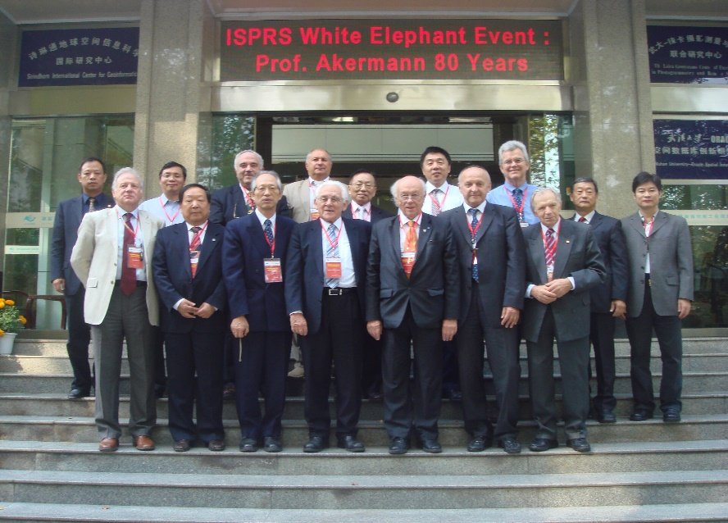
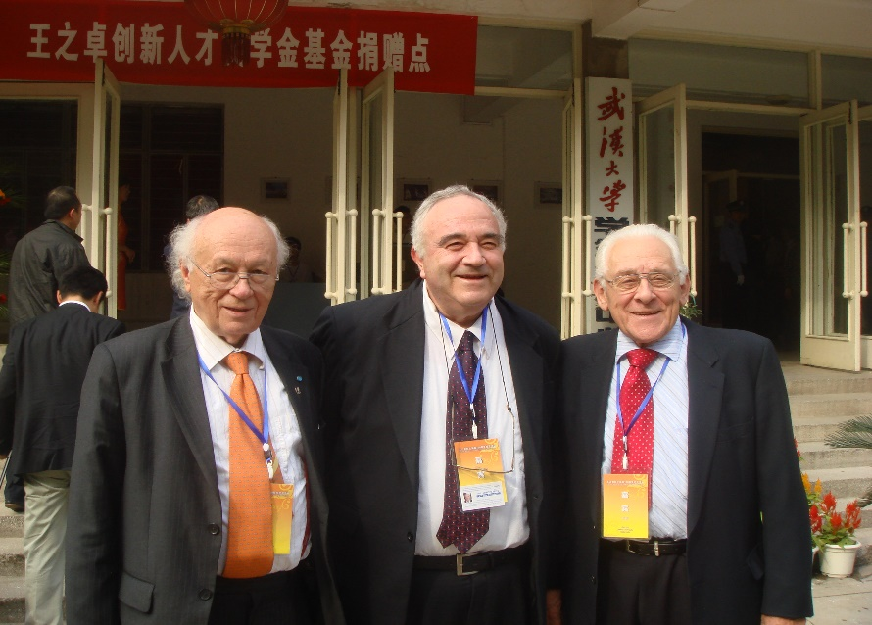
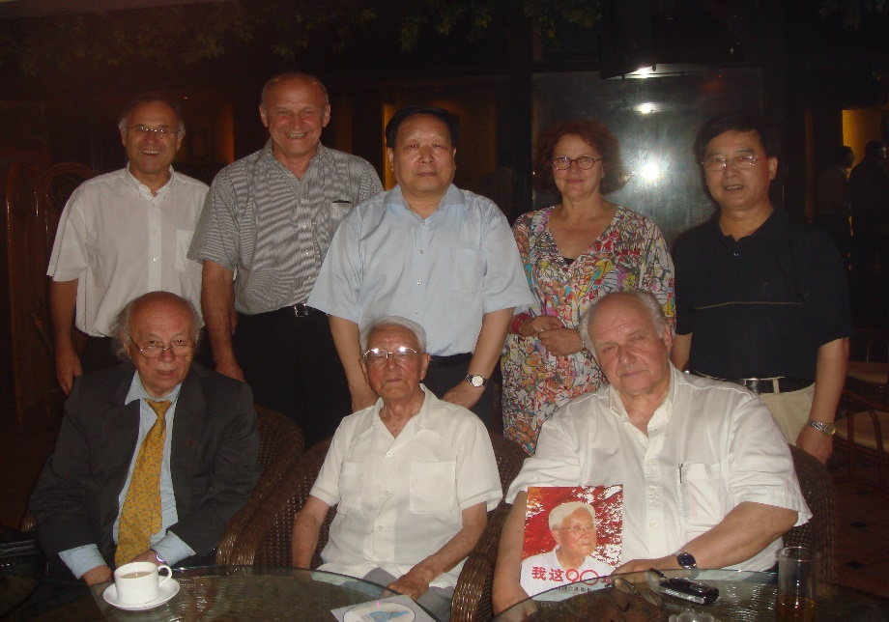
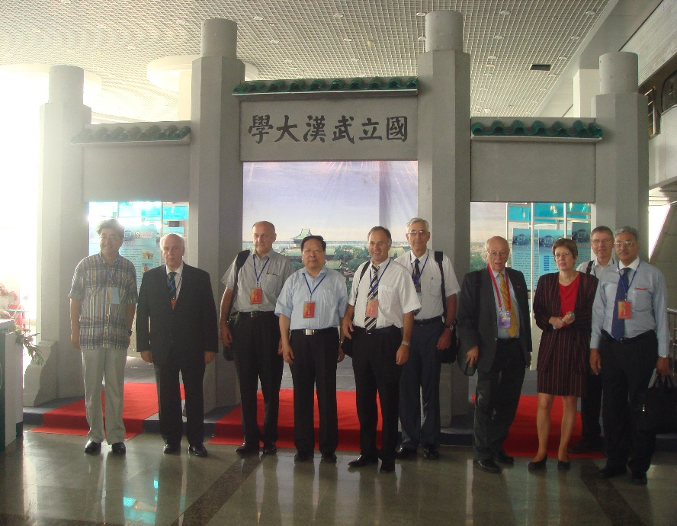
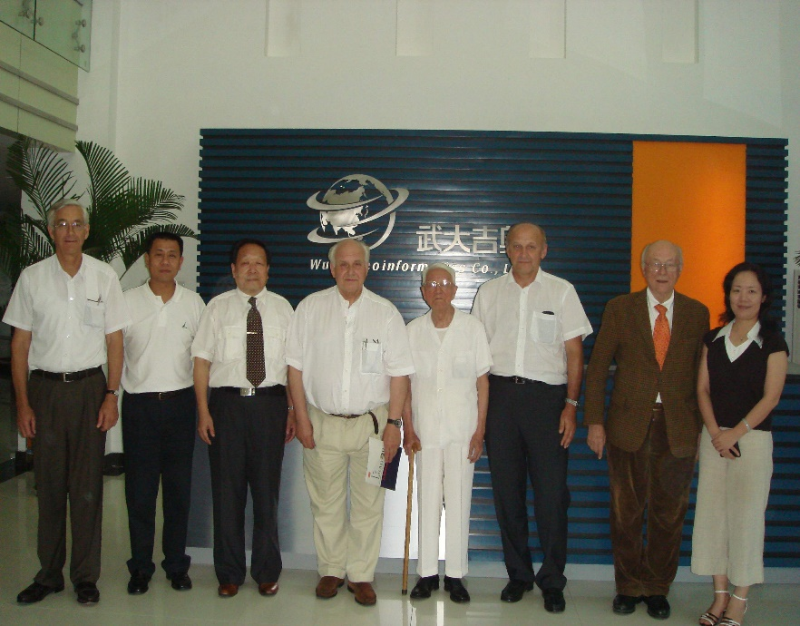
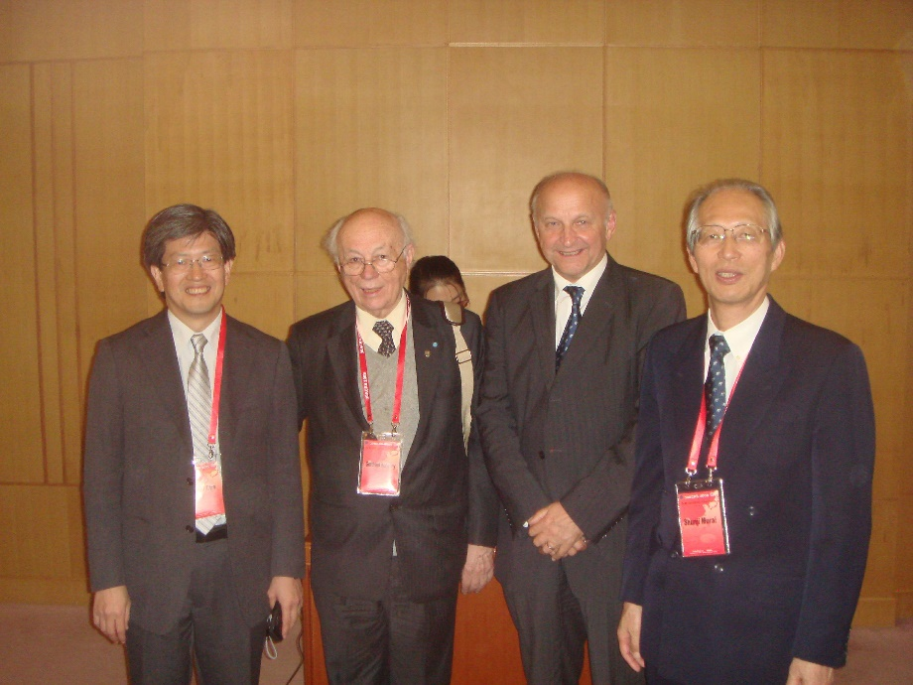
2009, Wuhan and Beijing, ISPRS White Elephant Event

Slide 14
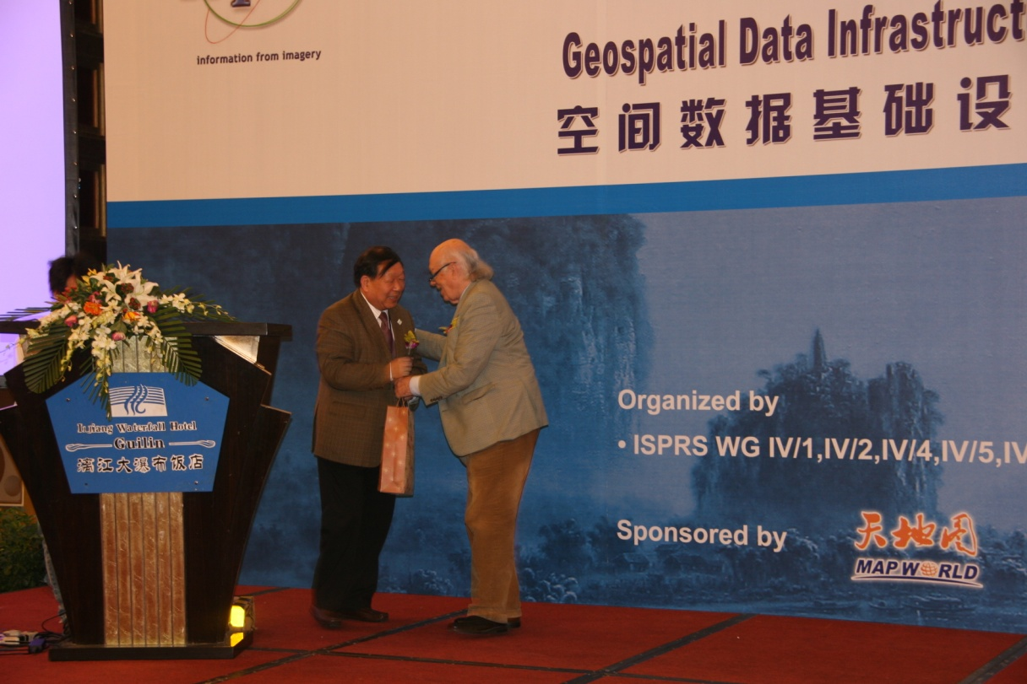
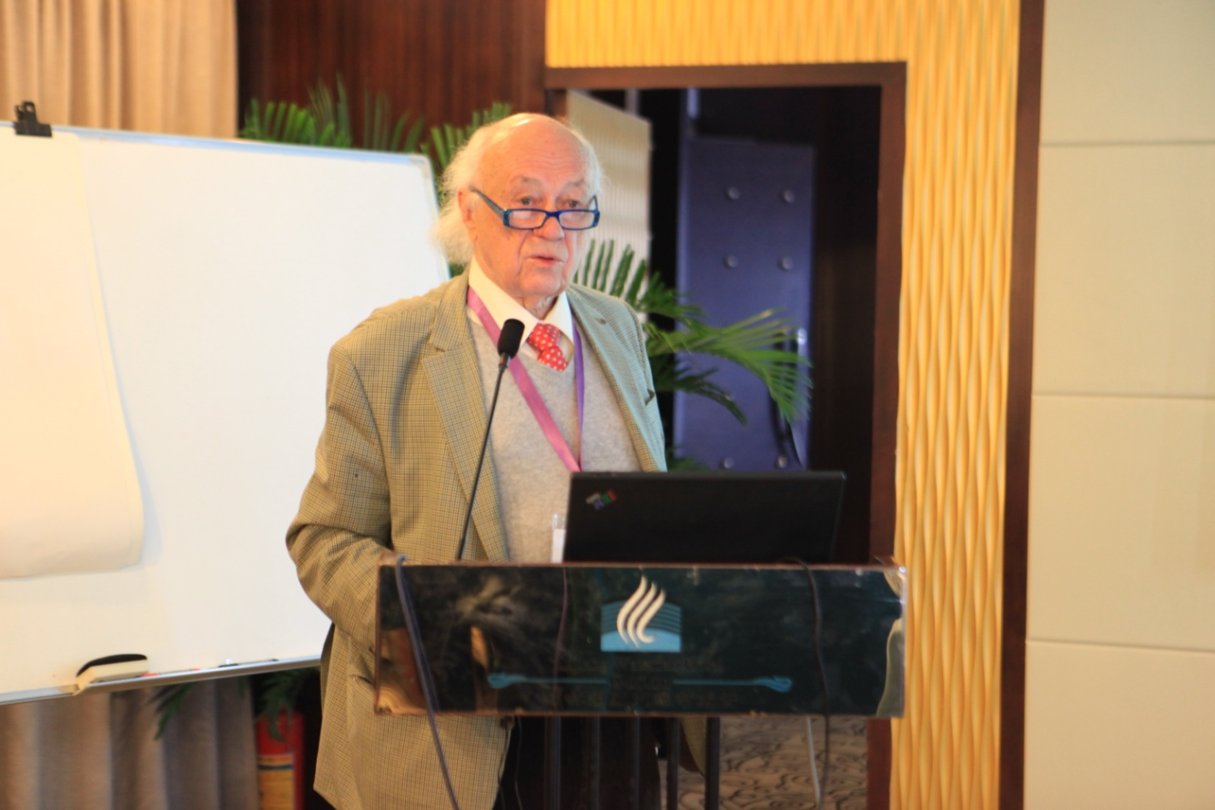
2011, Guilin, ISPRS Workshop

Slide 15
2012, Melbourne ISPRS Congress

Slide 16
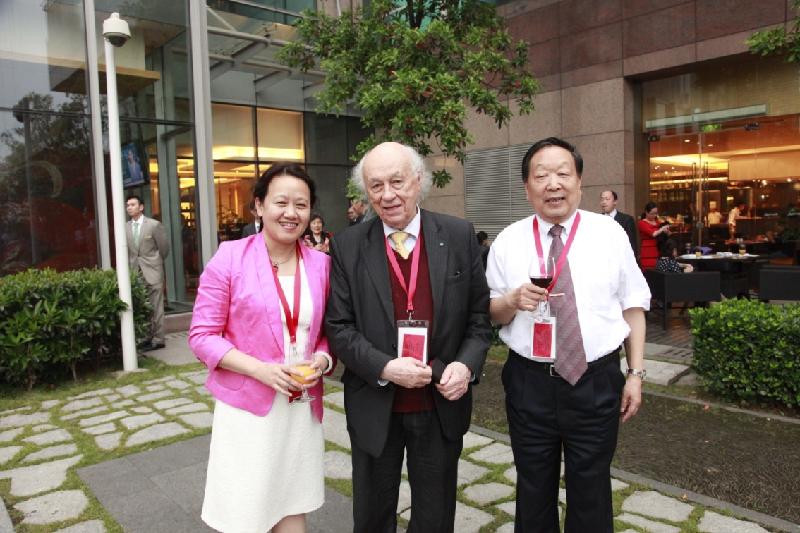
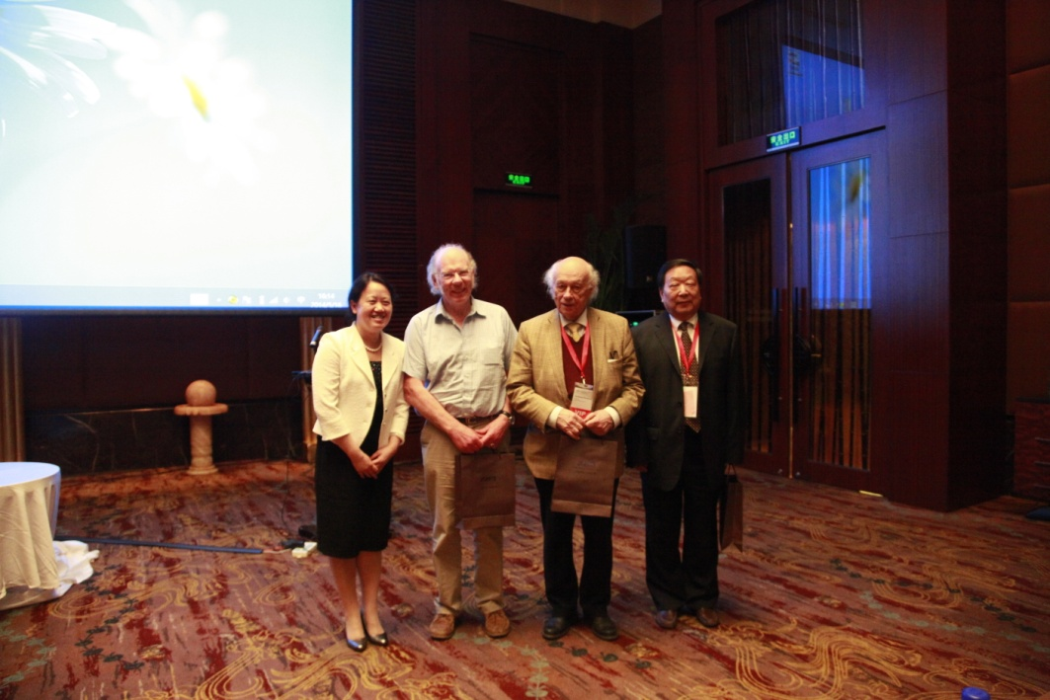
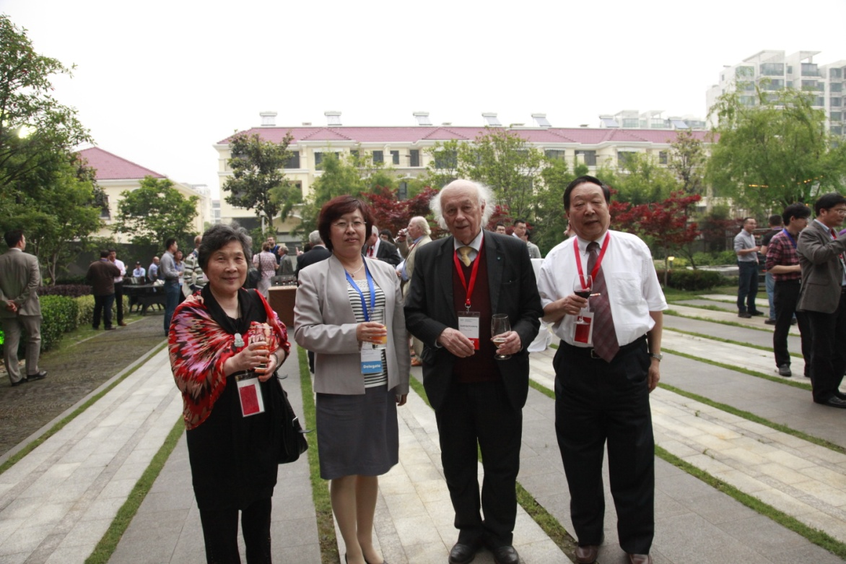
2014, Suzhou, ISPRS TC IV Symposium

Slide 17
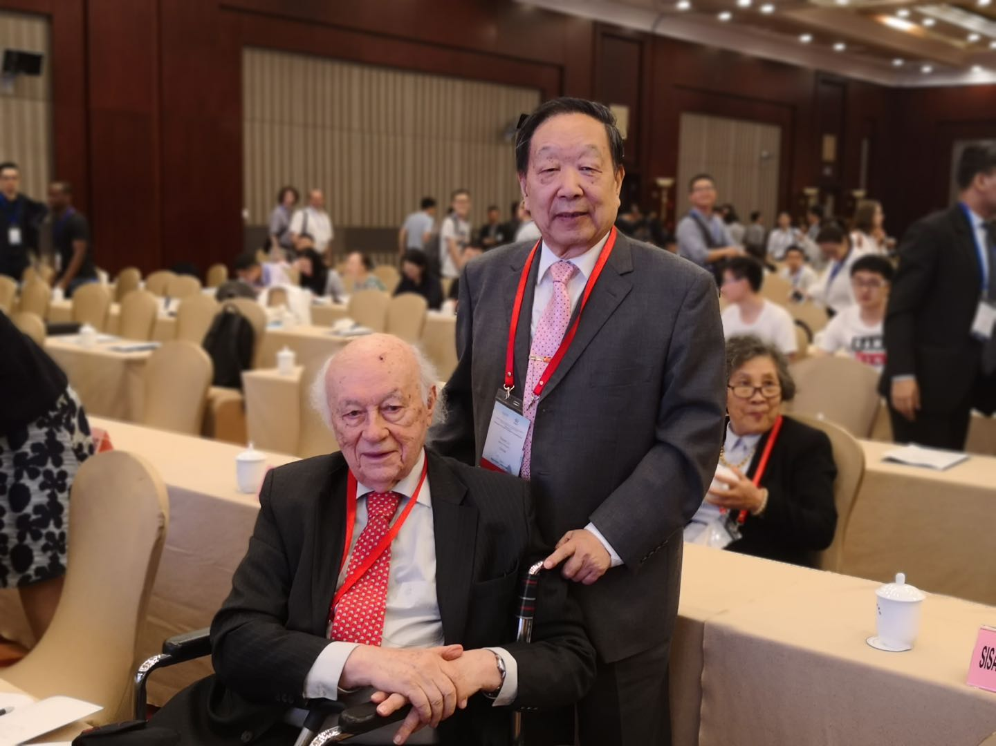
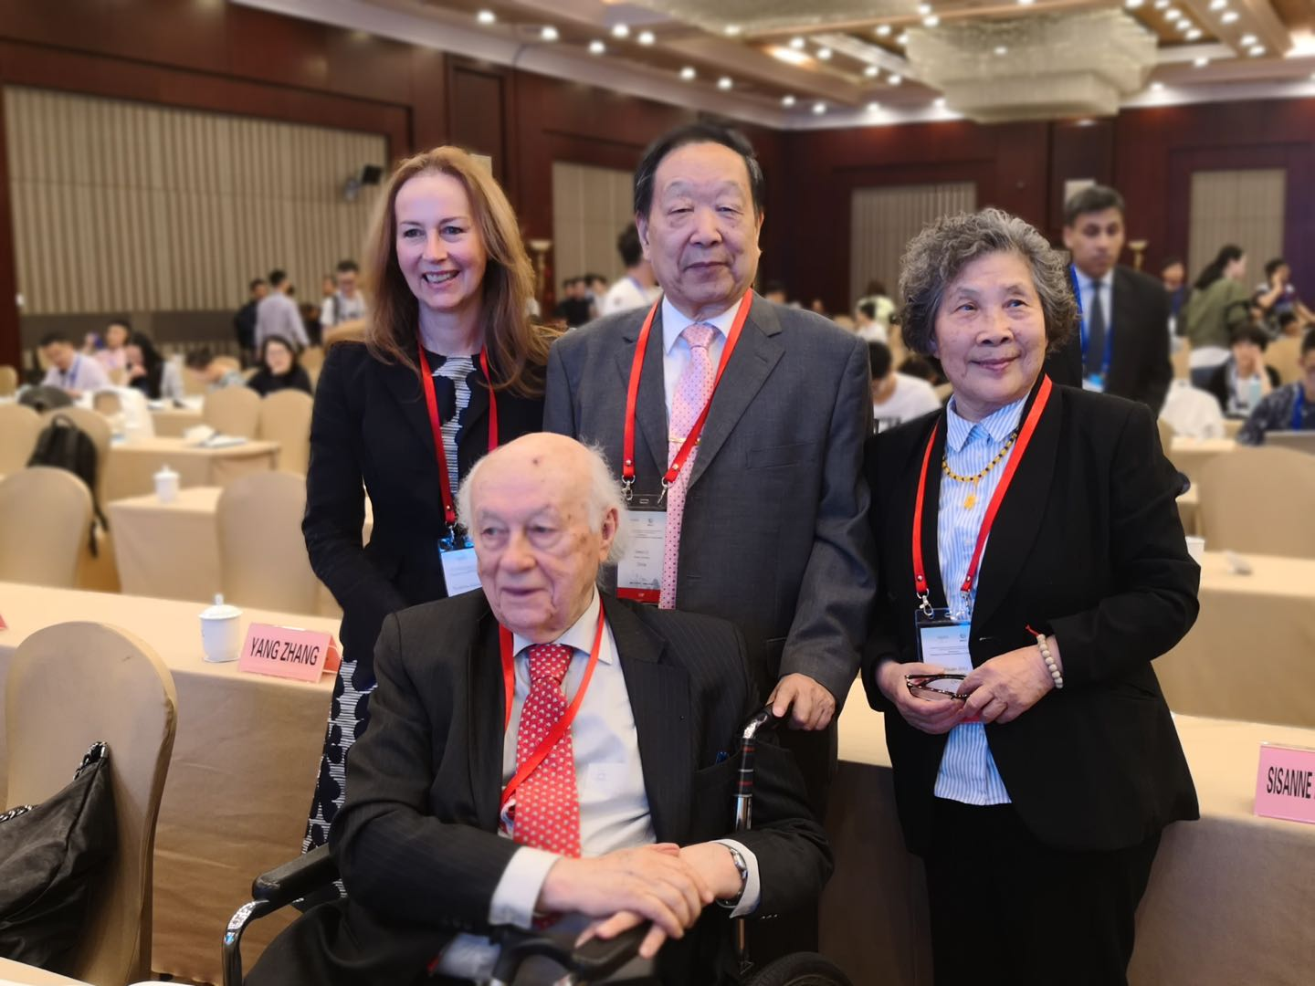
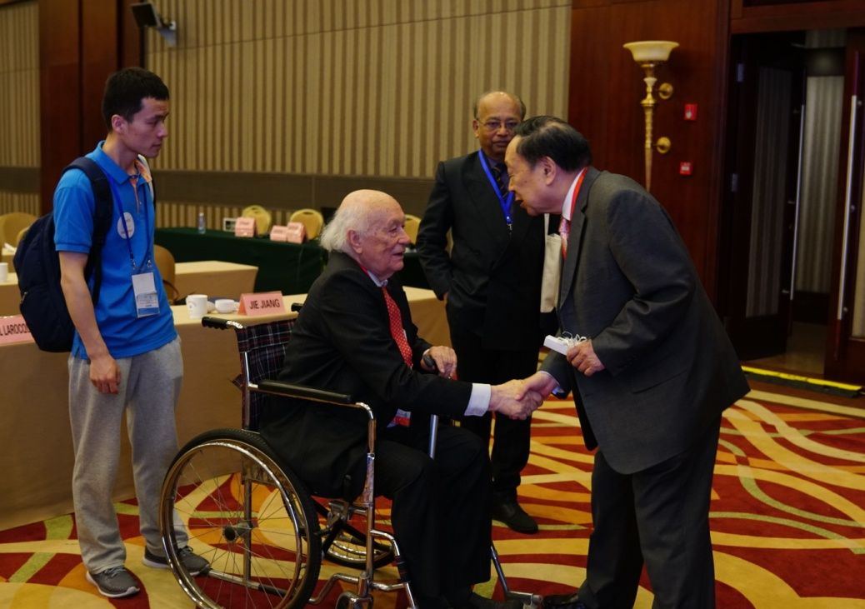
2018, Beijing, ISPRS TC III Symposium

Slide 18
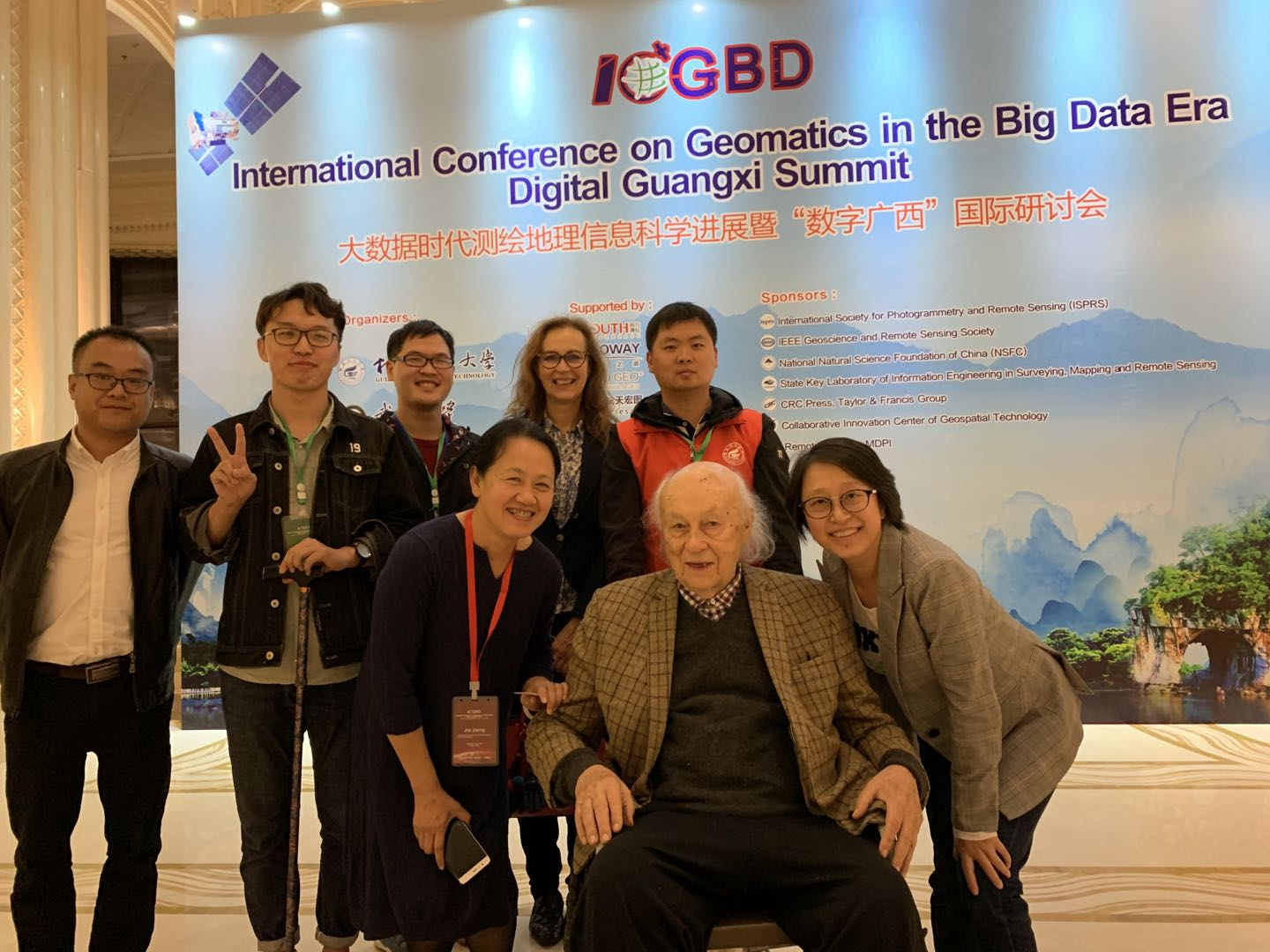
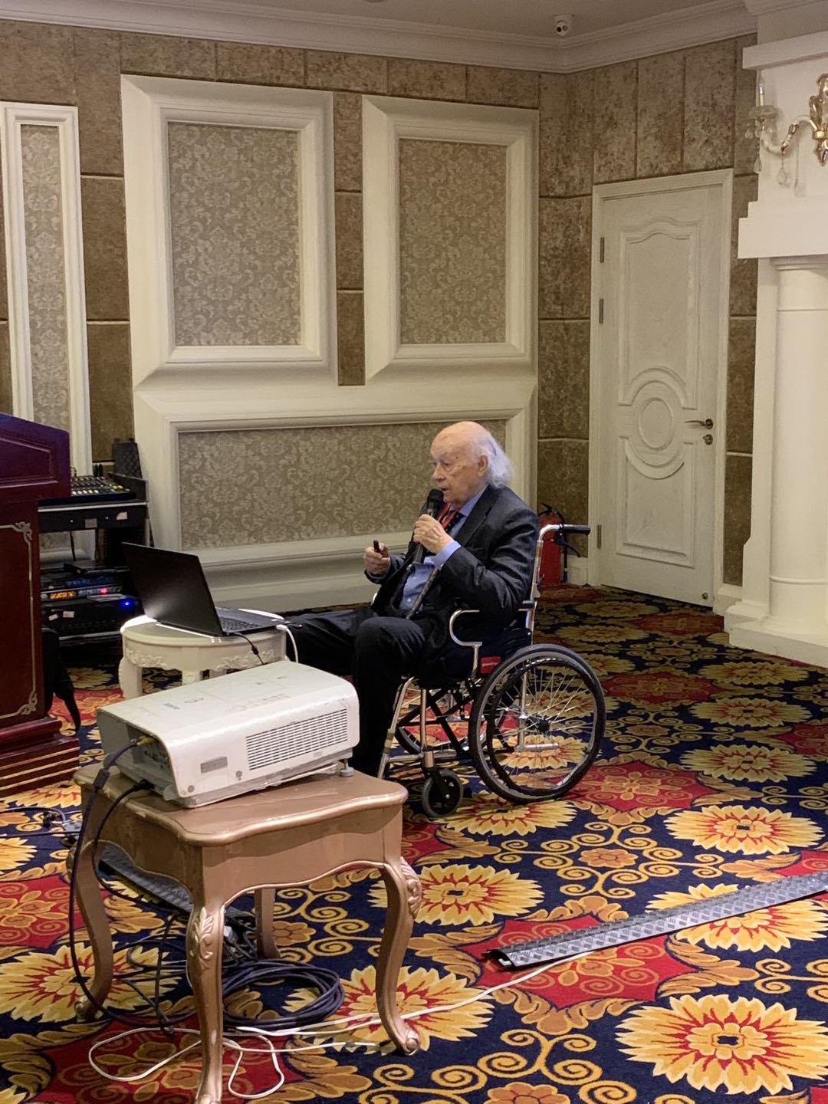
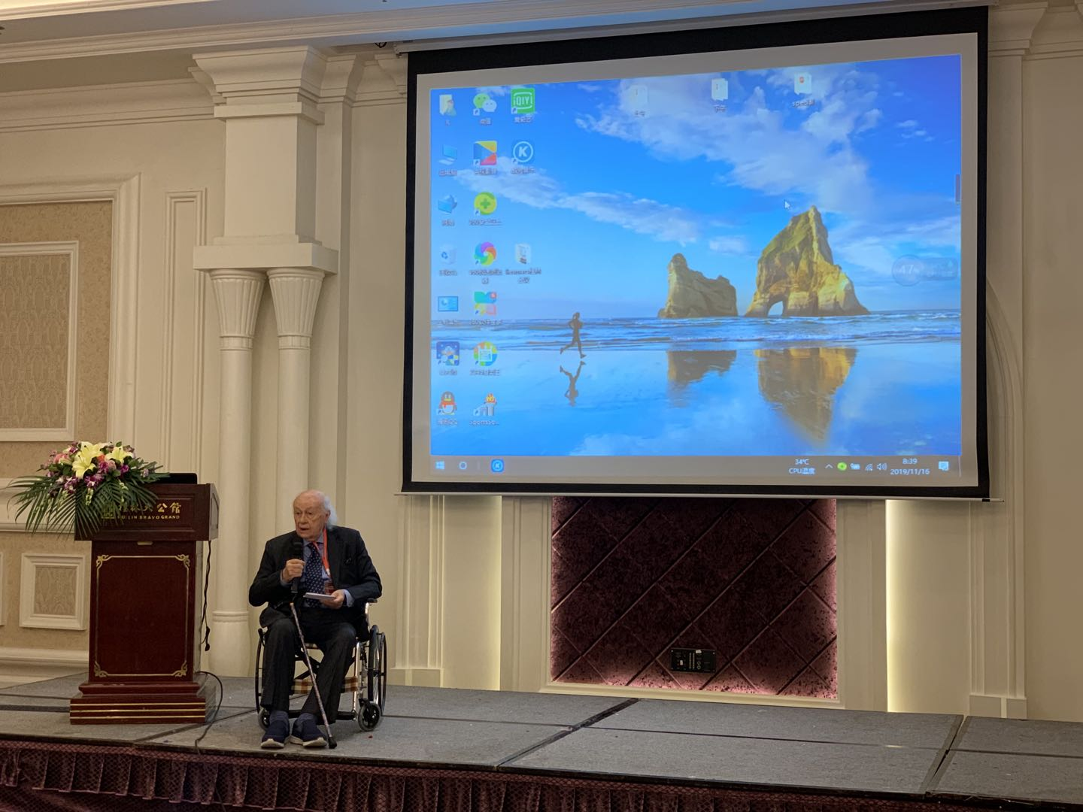
2019, Guilin, ICGBD and White Elephant Event

Slide 19
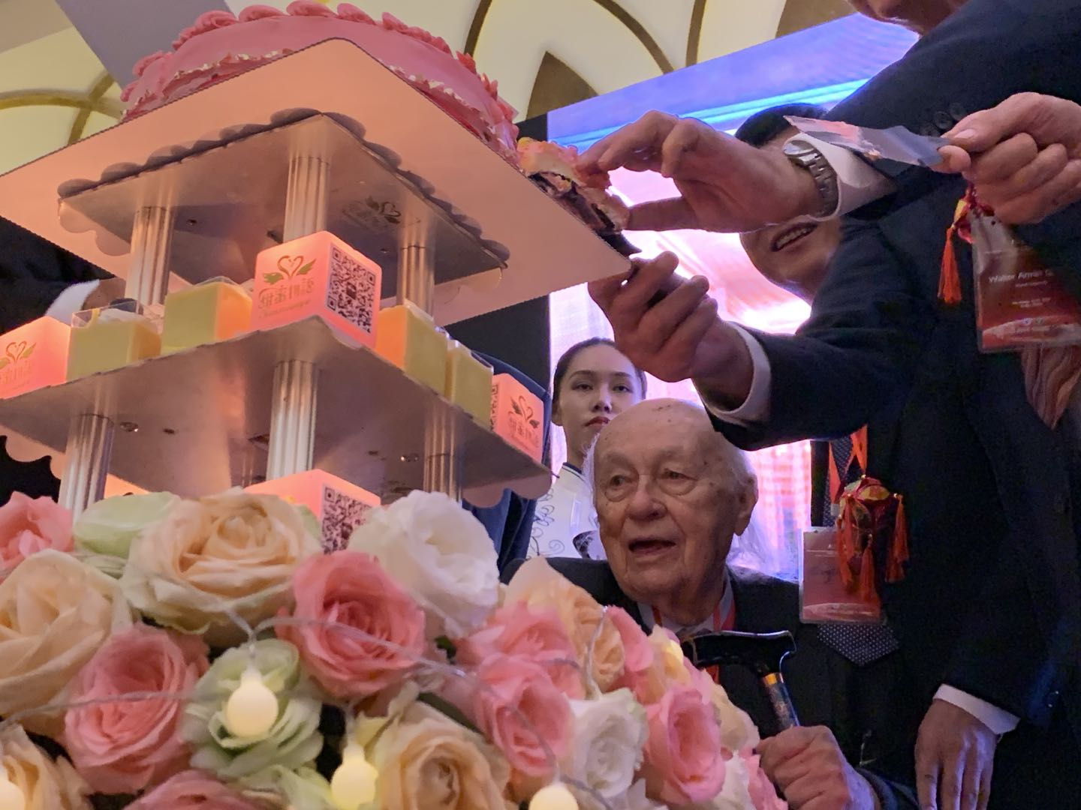
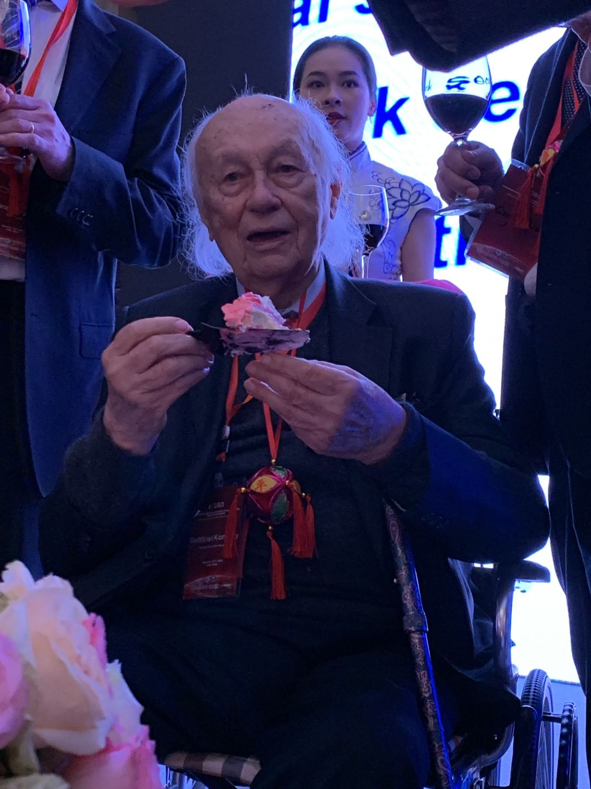
2019, Guilin, ICGBD and White Elephant Event

Slide 20
2019, Guilin, ICGBD and White Elephant Event

Slide 21
Longevity for Gottfried Konecny

Slide 22
中国摄影测量与遥感全体同仁祝康奈斯尼教授

